Slide 1
C# Fundamentals Introduccion
Presenter : Luis A. Salvatierra Soliz
Email: luis.salvatierra@jalasoft.com

Slide 2
C# Fundamentals Table of Contents
Important Concepts
C# First Look

Slide 3
C# Fundamentals Important Concepts
What is Computer Programming?
Creating a sequence of instructions to enable the the computer to do something.

Slide 4
C# Fundamentals Important Concepts
What is .Net Framework ?
A programming infrastructure created by Microsoft for building, deploying, and running applications and services that use .NET technologies.

Slide 5
C# Fundamentals Important Concepts
What is C#?
C# is an elegant and type-safe object-oriented language that enables developers to build a variety of secure and robust applications that run on the .NET Framework.

Slide 6
C# Fundamentals Important Concepts
What you need to program?
Knowledge of a programming language
C#
Integrate Development Environment,sdk.
Visual Studio, .net framework skd.
Help Documentation
MSDN Library, tutorials, etc

Slide 7
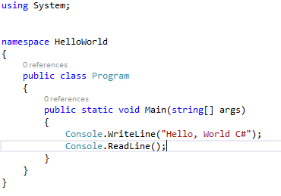
C# Fundamentals C# First Look
Hello World C#

